Slide 1
Social Media Investigations
04/08/2019

Slide 2
Social media investigations
Tools for social media investigations
A You-Tube video DEFCON “Now You See Me, Now You Don’t” – by Joey Muniz and Aamir Lakhani

Slide 3
People Search
People searching- background checks on individuals depend on:
  Public information- public court records, arrest records, property tax records, marriage records, and other snippets of information.
A lot of the things you do on the Internet are recorded, so they continue to live on the Internet(digital footprint).
Searches depend on public records.
The information you can find on someone might depend on where the person lives - countries, states, and cities have different privacy laws.

Slide 4
General rule for social media investigations
Before doing a search –
  Make sure you have the most unique characteristics about someone - country, city, and state where the person resides.
  Any personal information such as a phone number, employment history, or any other details could be helpful to find data on that person and to validate you have found the right person you are looking for.
Nothing is for free:
  Most of these people search sites offer basic search features and then offer a report costing between $40 and $70

Slide 5
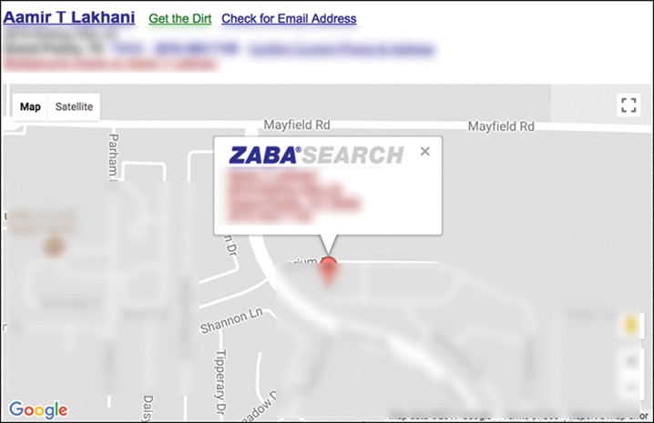
Where do you start?
Zabasearch is a good place to start for free public searches.

Slide 6
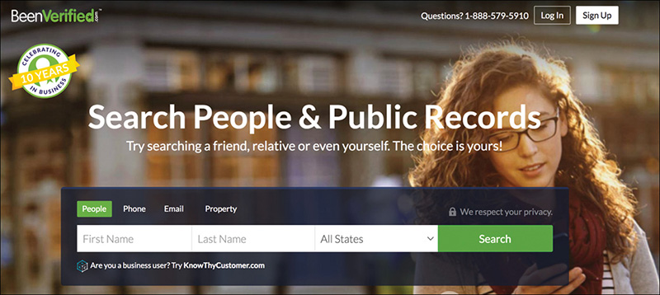
More professional sites
BeenVerified
  A premium site that provides a consolidation of public records

Slide 7
Pipl
Search engine for websites
Search and correlate information relating to social media, general usernames, and locations within a search query.
  Social networking accounts, LinkedIn profiles, blogs, news articles, address books
I used the username OneNicePerson on some websites, such as a forum, an Amazon review, or some social media site.
  Can use pipl to know who that username belongs to, so you could easily check for this username to start an investigation

Slide 8
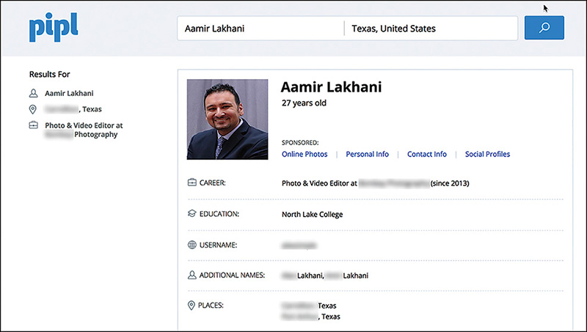
Using an email address in pipl

Slide 9
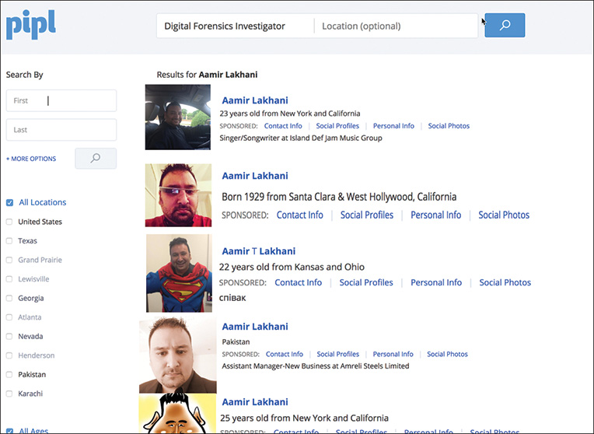
If you know the user name (OneNicePerson)

Slide 10
Doing people searches
Researching people is a process.
When you find one record, you sometimes can link it to a name, an address, and then perform an extended background check.
Can link various usernames such as social media usernames to eBay accounts
Why would this technique be valuable?

Slide 11
Scenario and video
Imagine you want to know when an employee of a company is selling something on eBay. That something could be a mobile phone or hard drive that could contain sensitive information.
There is some excellent research on social media investigations
“DEFCON Now You See Me, Now You Don’t” or go directly to the URL: https://www.youtube.com/watch?v=QiDpGezol0o&t=64s

Slide 12
Geofeedia
A tool that searches and analyzes social media geographical locations in real time.
Help organizations → users and customers location or where they might like to hang out, shop, live, and do other geographically-related activities.
Can be used to find the geolocation of a person and help a forensics investigator identify that person.
A user can select a specific geographical area and search for all the social media posts in a specific area.

Slide 13
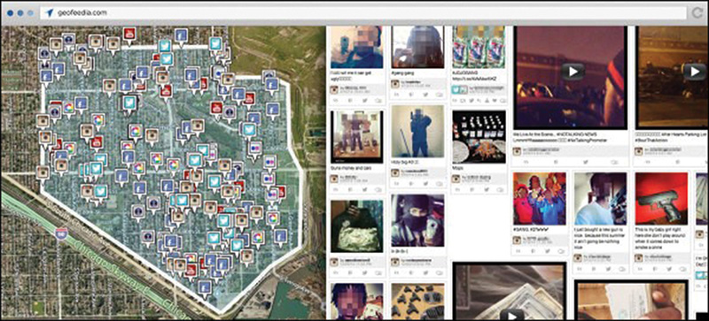
Geofeedia

Slide 14
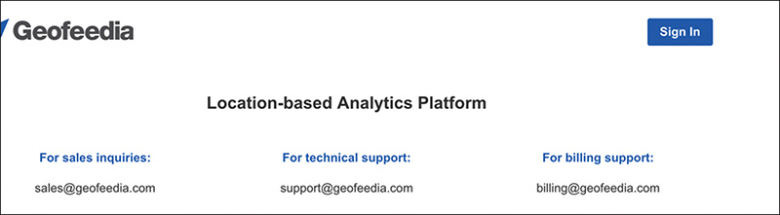
Geofeedia login

Slide 15
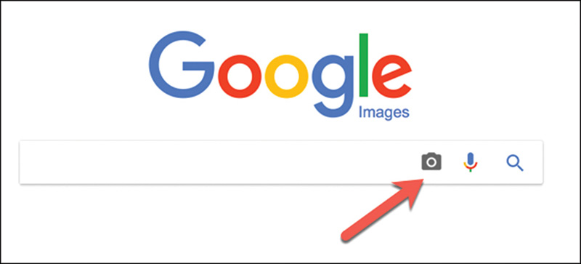
Google Search
Have you ever wanted to know whether a picture of a person on the Internet was really that person?
Go to http://google.images.com and click on the camera icon and upload questionable picture →see where specific picture was used on the Internet.
Question: Is the picture tied to the same identity?

Slide 16
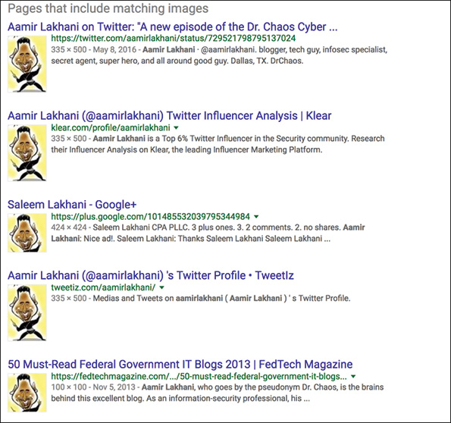
Is the picture tied to the same identity
Results with the same picture →have multiple names, locations, or careers, then most likely the picture is fake or stolen. Same?

